Slide 1
FEM Simulation before Fabrication
Arjun Narayanan
Lucas Smyk

Slide 2
Problem and Motivation
Problem
Simulate the behavior of elastic and plastic materials before fabrication
Motivation
Because 3D printing an object is costly in time and materials, we want our material to behave correctly prior to fabrication

Slide 3
Background on Simulation of Deformable Objects
Mass Spring System
Simple approach
Cloth and hair
Finite Element Simulation
SIGGRAPH course = tetrahedral elements
We will use hexahedral elements
UROP experience: hexahedral FEM simulation on GPU

Slide 4
Proposed Technical Method
Important Design Decisions
3D Hexahedral Elements
Easy to construct meshes
C++ application
NVIDIA CUDA to improve performance
Measure properties of MakerBot plastic
Incorporate material model into code

Slide 5
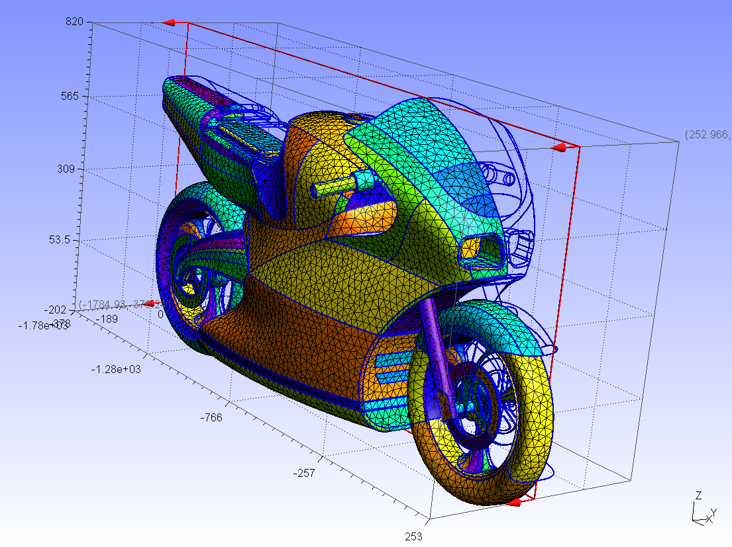

Slide 6
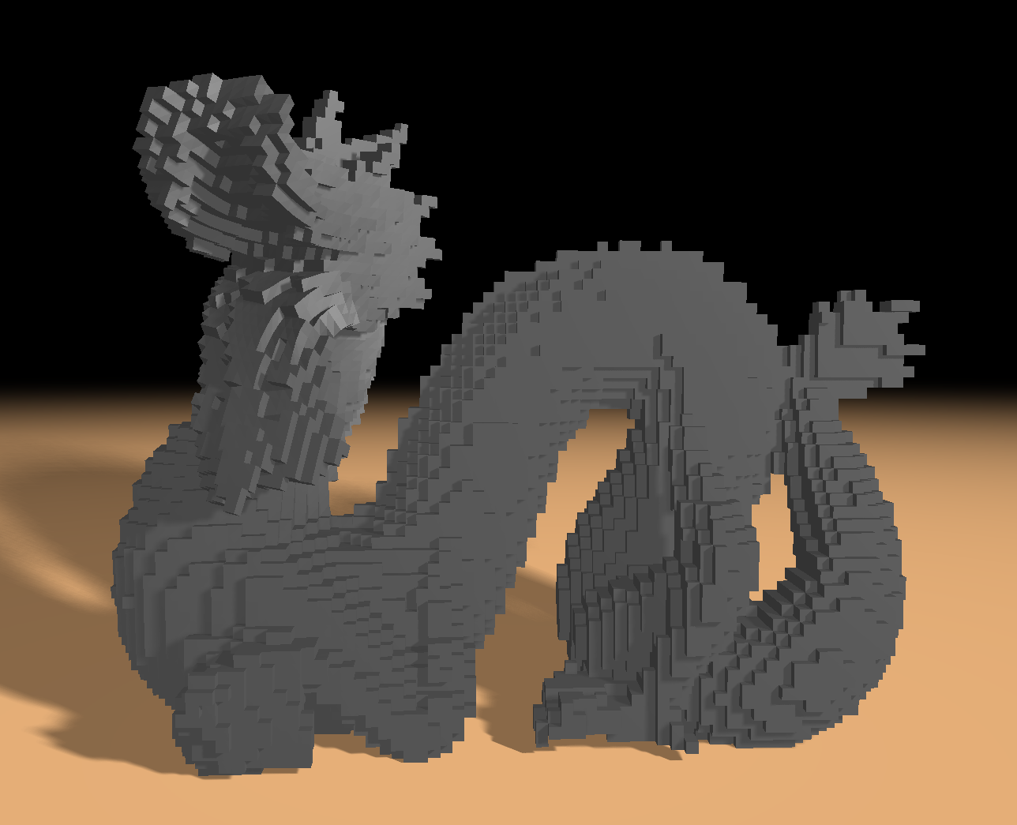

Slide 7
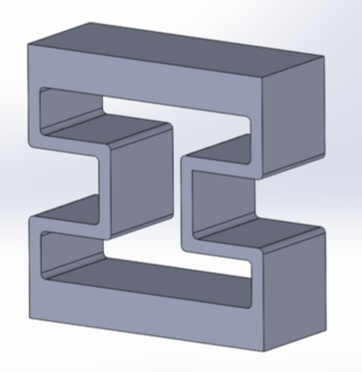

Slide 8
Proposed Technical Method (cont.)
Project plan:
C++ FEM software for statics and dynamics
Test the simulation
Build material model for MakerBot plastic
Simulate the behavior of an object. 3D print the object and check results.
If time, simulate, build, and test more complicated models.

Slide 9
Expected Results
Expected Results
Results of simulation should bed close to real-world behavior after printing
Start with simple objects and work our way up
Difficulties
Accurately measuring the material properties of the MakerBot plastic
Constructing good material model

